Slide 1

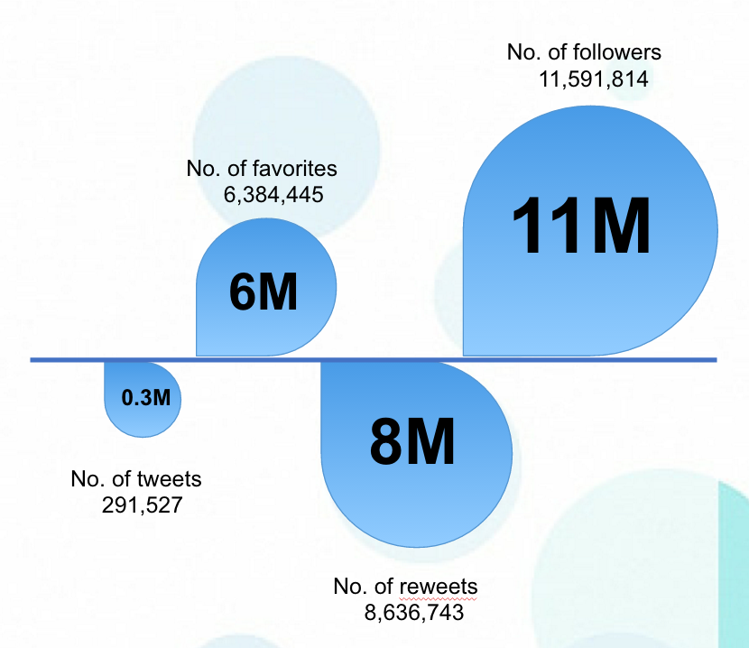
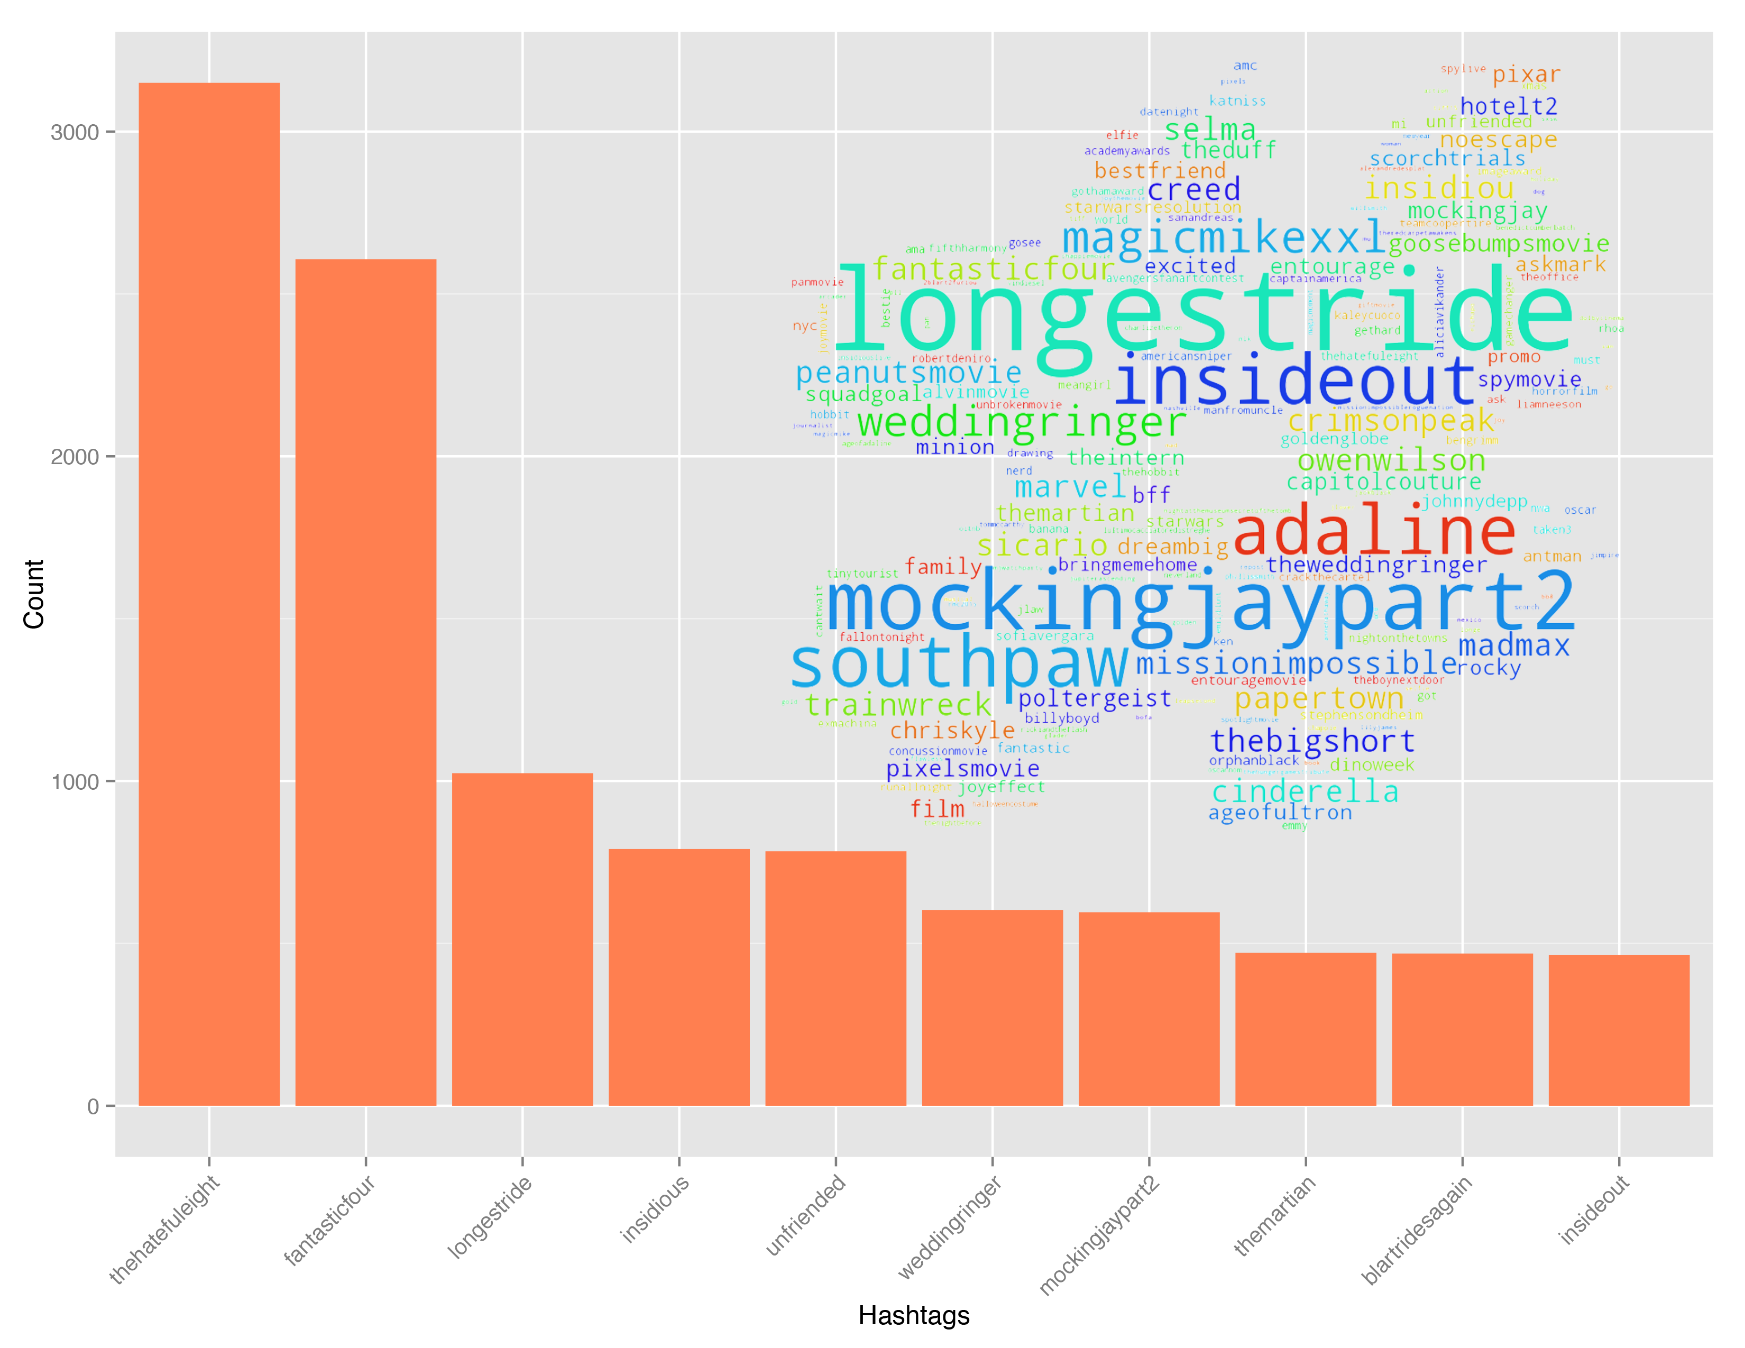

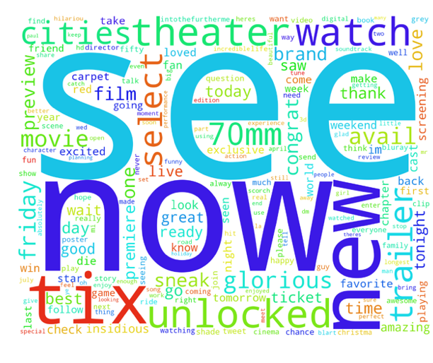
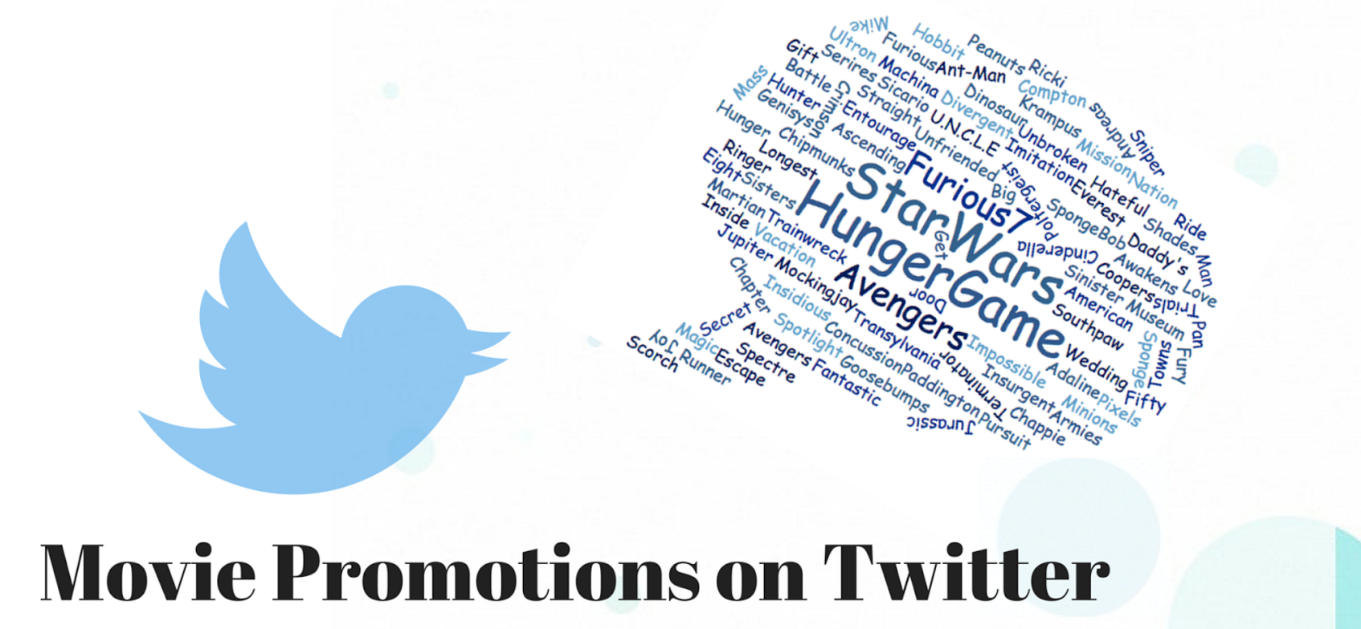
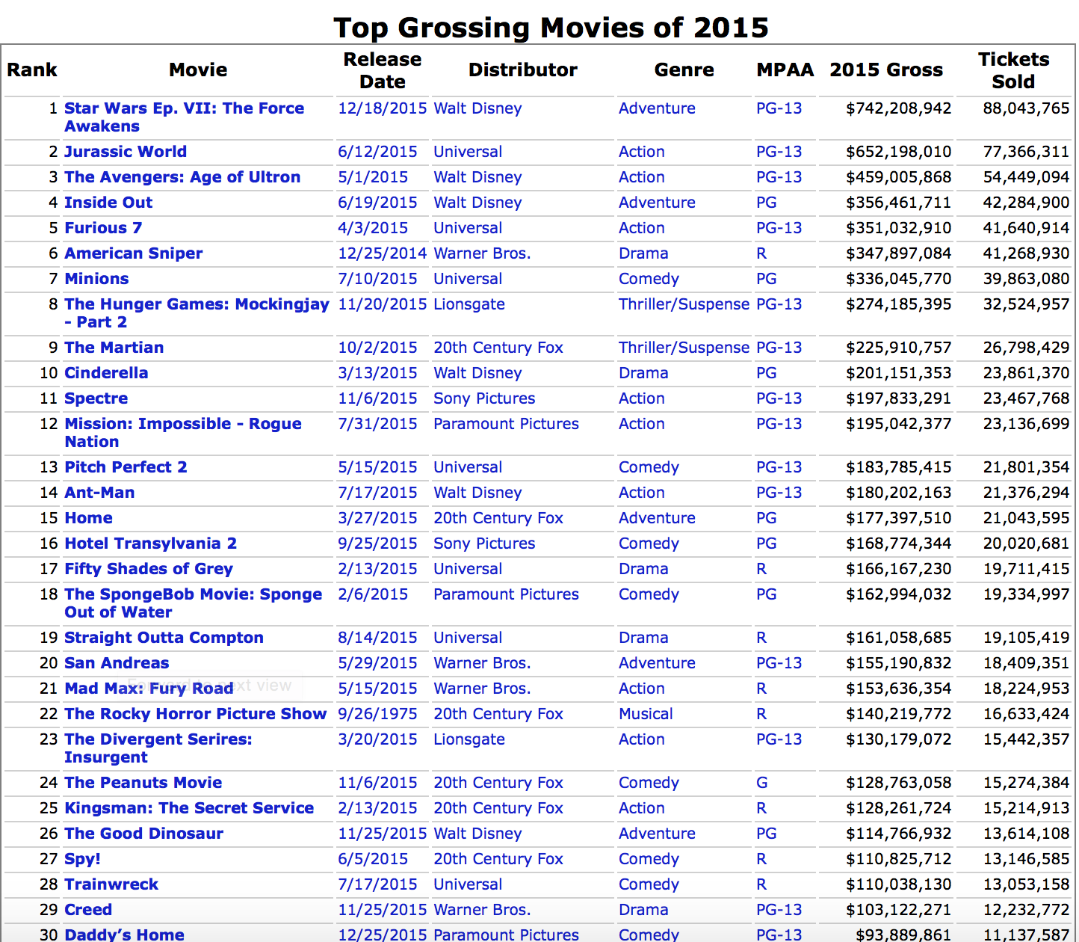
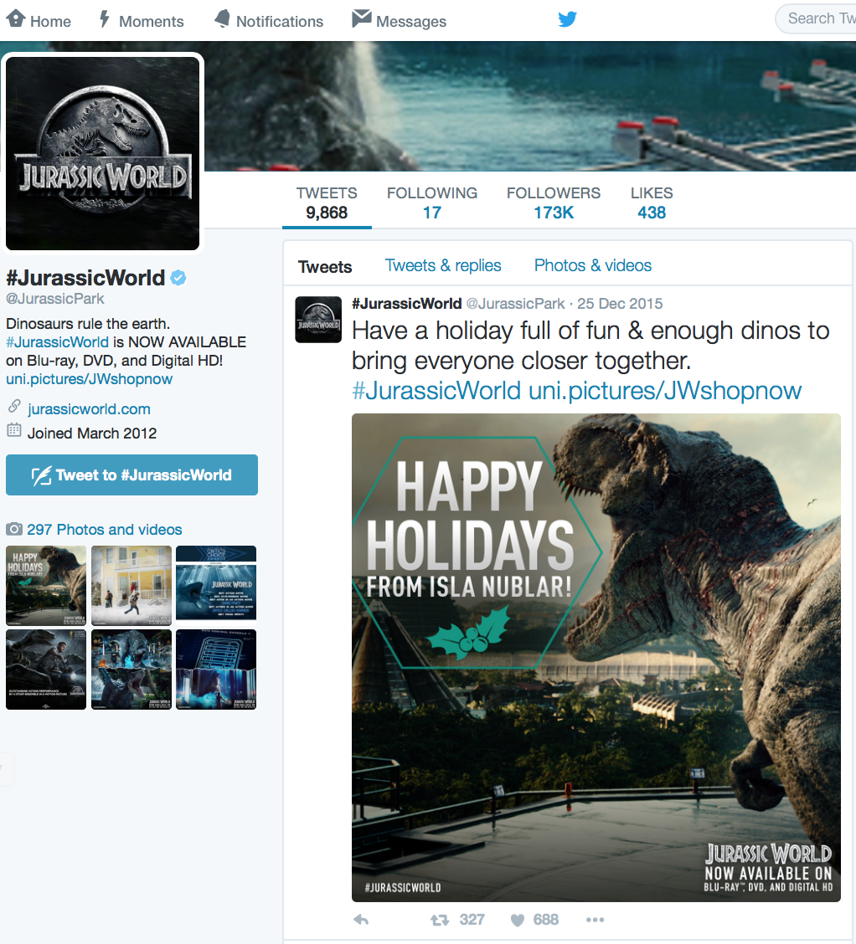
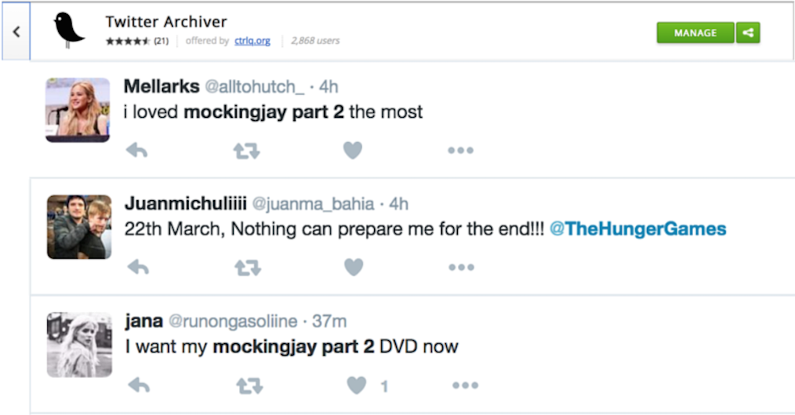

2015 Top 100 Grossing Movie Promostions on Twitter
Hoang Duong Trong, Cenzhuo Yao, Lu Zhang, Luyun Zhao, Sicun Huang, Thibault Doutre
Motivation
Word Cloud
Promotion and Sales
Twitter is a free online platform which reaches out to 300 millions users around the world at anytime. Movie Distributors may think: is Twitter an ideal platform to promote movies?
After counting the number of occurrences of words in tweets related to the official movies accounts in 2015, we obtain this cloud, where the size of the word is proportional to the frequency.
The Correlogram shows there are strong positive correlations between:
● number of followers of the movie on Twitter and movie’s box office sales
● number of reviews of the movie on IMDB and movie’s box office sales
● Confirmed:
They are positively correlated
● Predictable Outliers:
Ted2 has lots of followers on Twitter but the sale was really low, one explanation is that people have high expectation on this movie based on the performance of Ted1, however it turned out to be a bad movie
The official twitter accounts for the top-grossing movie of each year is increasing, and in year 2015, there are 89 movies out of 100 that have official twitter account to promote their movie, among which there are 0.3 M tweets, 6M favorites, 8M retweets and 11M followers online. Therefore, the data here shows that Twitter is a giant and growing market full of potential audience, which makes promoting movies on twitter becomes really important.
● Confirmed:
They are positively correlated
● Predictable Outliers:
The cluster contains four cartoon movies, the majority audience of which are children. Therefore, it makes sense that they don’t get so many reviews while have a good performance on sales.
Objective
● Distributors have 5-17 movies among the top 100 of 2015. ● For each distributor, it's normal that one or two popular movies dominates the number of followers of the whole group.
We already know Twitter is an ideal platform to promote movie, now how should the movie distributor use this source effectively to make the movie success? Here,
We proposed to evaluate how the movies promotion on Twitter affects the Box office sales. To do so, we analyzed the 89 movies out of the top 100 grossing movie of 2015 who have the official Twitter account and raised several questions:
● What are the most frequently used words by distributors? The top 10 hashtags?
● What are the different promotion styles used by distributors?
● How are the Twitter/IMDB account features related to Box office performance?
● What are the public opinions on these movies?
Machine Learning Techniques
Data Source
● Twitter REST API: timelines and user info from the 89 official movie accounts
● Twitter Achiver Search API: public opinions about the 89 movies
● The-numbers.com: the top 100 grossing movies of 2015 and sales performance
● IMDB: rating and reviews information about the 89 movies
Result: Most positive and negative words, as measured by their correlation with positive and negative tweets.
Sentiment of different Twitter keywords using text-processing.com API. We run our own Random Forest algorithm on the labeled dataset to and obtain a 75% accuracy on classifying positive and negative tweets. Due to the not so perfect accuracy, we use a trained model obtained from text-propressing.com instead. This model can classify a tweet along two dimension, whether it is negative or positive, and whether the sentiment is neutral or intense. Basically, if the intense score is less than 0.5, it is classified as neutral tweet. Otherwise, it is classified as positive or negative depending on the positivity score.
Running k-means on first 10 Principle Components, the conclusion is that there are six outliers who always spam while other seems to have similar promotion style
We obtain a label dataset from Sentiment140.com, containing 1.5 million tweets with label of 0 for negative, and 1 for positive. We then construct the bag of words matrix, with a vocabulary of 5000 words. We then rank the words by their correlation with the sentiment label to find the most negative and most positive words. We note one interesting fact that beside obvious positive words like “happy“, “haha”, “lol”, word about other people and showing appreciation like “your”, “you’re”, and “thank” are also associated with positive tweets. On the other hand, words talking about oneself such as “I”, “me”, “my” are more associated with negative tweets.

